Slide 1

Influence Style Indicator ©2010, 2015, Discovery Learning International – All rights reserved.

Slide 2

TAKE A STAND
Shout Out
Shout out which one most appeals to you.
1) Lion
2) Owl
3) Bear
4) Deer
5) Dolphin
Influence Style Indicator ©2010, 2015, Discovery Learning International – All rights reserved.

Slide 3
TAKE A STAND
Shout Out
Shout out which one most appeals to you.
1) BMW
2) Porsche
3) Mini Van
4) Truck
5) Motorcycle
Influence Style Indicator ©2010, 2015, Discovery Learning International – All rights reserved.

Slide 4
TAKE A STAND
Shout Out
Shout out which one most appeals to you.
1) Inventor
2) Thinker
3) Doer
4) Planner
5) Facilitator
Influence Style Indicator ©2010, 2015, Discovery Learning International – All rights reserved.

Slide 5
WHY INFLUENCING MATTERS?
Change and complexity
Flatter and/or matrixed organizations
Team approaches to work, often with dispersed membership
Greater collaboration and coordination across boundaries
Decision making and time issues generated by increased collaboration
Influence Style Indicator ©2010, 2015, Discovery Learning International – All rights reserved.

Slide 6

POWER: The capacity or potential to exert influence
Positional Power
Personal Power
Power based on formal status, authority, control of resources, punishments or rewards
Power based on expertise, special skills, personality traits, charisma, personal status or credibility
Influence Style Indicator ©2010, 2015, Discovery Learning International – All rights reserved.

Slide 7
INFLUENCING DEFINED
“The interpersonal behaviors that we use, to have a positive impact on another party’s choices.”
Influence Style Indicator ©2010, 2015, Discovery Learning International – All rights reserved.

Slide 8
TO INFLUENCE EFFECTIVELY
Understand and personally align to the company direction and priorities
Understand and personally align to the culture and values
Take action even if you don’t have the authority over resources
Build confidence through proven execution
Demonstrate concern for others as well as self
Influence Style Indicator ©2010, 2015, Discovery Learning International – All rights reserved.

Slide 9
WAYS TO TELL IF YOU HAVE INFLUENCE
Can work around policy or rules
Access to vital information
Involved in important decisions
Can influence a change outside your role / area
Access to resources
Copied on correspondence
Influence Style Indicator ©2010, 2015, Discovery Learning International – All rights reserved.

Slide 10
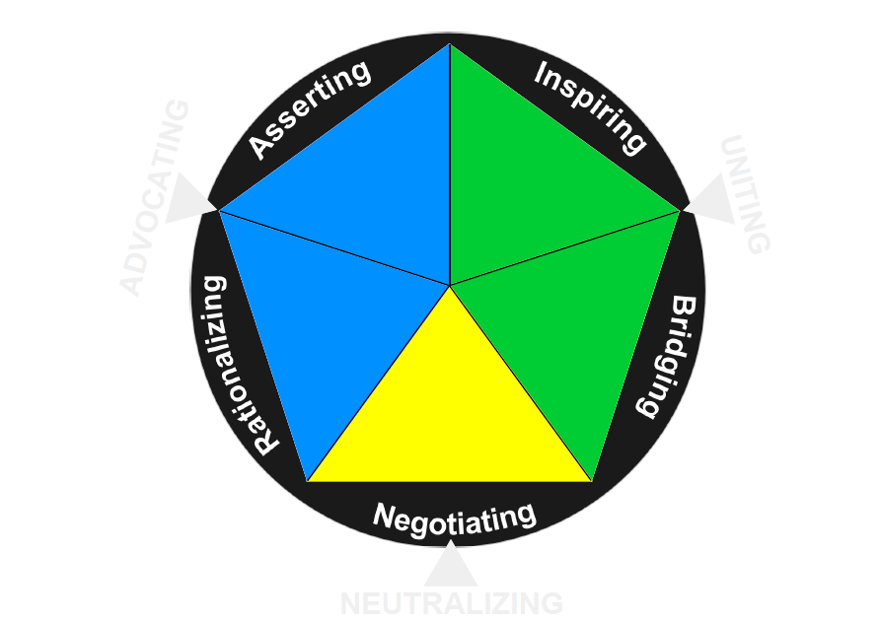
THE ISI MODEL: INFLUENCE STYLES
You advocate by debate, insisting your ideas are heard and challenging the ideas of others.
You advocate by presenting a sense of shared purpose and exciting possibilities
You advocate by connecting, building relationships and coalitions
You advocate by
offering logic, rational reasons and data
You advocate through compromises, concessions and trade-offs to reach outcomes that satisfy your greater interest.
Influence Style Indicator ©2010, 2015, Discovery Learning International – All rights reserved.

Slide 11
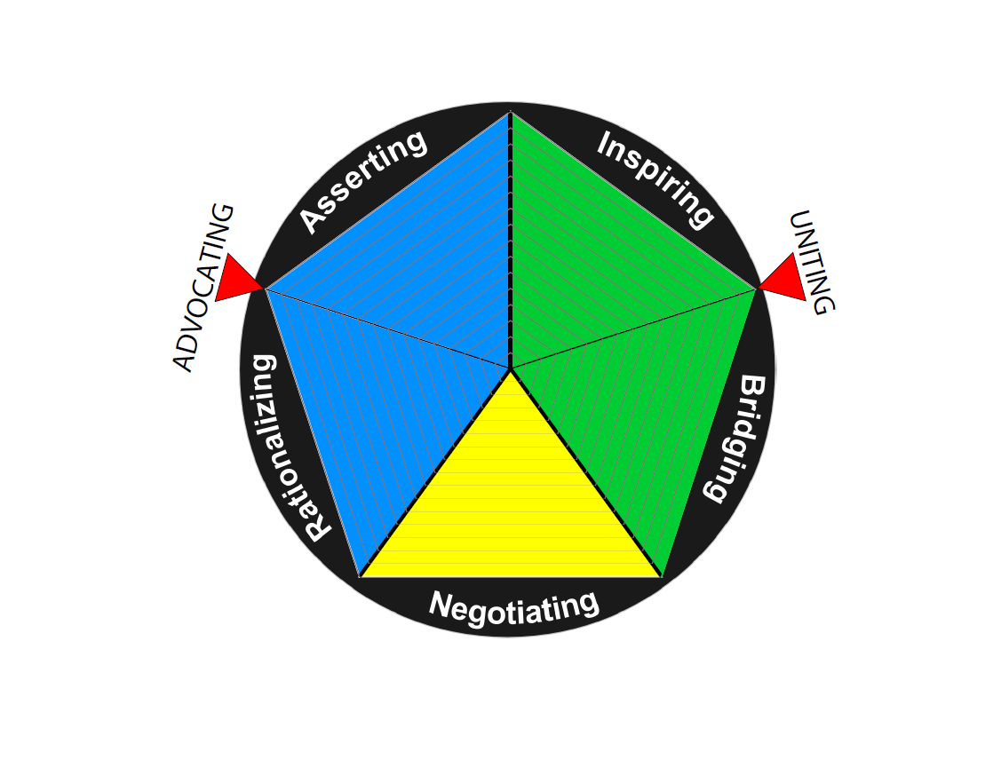
THE ISI MODEL: INFLUENCE ORIENTATIONS
Influence Style Indicator ©2010, 2015, Discovery Learning International – All rights reserved.

Slide 12
ASSERTING STYLE: STATING PREFERENCES CLEARLY AND APPLYING PRESSURE
This Style looks like…
Insisting that your ideas are heard and considered
Challenging ideas or suggestions that you disagree with
Using formal structure (position, rules, laws, policies) to emphasize legitimacy
Using power, rewards and consequences
Influence Style Indicator ©2010, 2015, Discovery Learning International – All rights reserved.

Slide 13
ASSERTING SOUNDS LIKE…
I am 100% certain that…
I insist that you consider my idea…
My position gives me the authority to…
The policy requires that…
Influence Style Indicator ©2010, 2015, Discovery Learning International – All rights reserved.

Slide 14
RATIONALIZING STYLE: USING LOGIC AND REASONING TO PRESENT YOUR IDEAS
This Style looks like…
Offering rational reasons to convince others of your point of view
Suggesting logical solutions to problems
Using relevant facts and data to convince
Using expert views and/or historical data to build a convincing position
Influence Style Indicator ©2010, 2015, Discovery Learning International – All rights reserved.

Slide 15
RATIONALIZING SOUNDS LIKE…
Our analysis shows that…
The experts say...
What information do you need to…
The only logical solution is to…
Influence Style Indicator ©2010, 2015, Discovery Learning International – All rights reserved.

Slide 16
NEGOTIATING STYLE: COMPROMISING AND MAKING CONCESSIONS TO FIND COMMON GROUND
This Style looks like…
Willing to make concessions in order to reach an outcome that satisfies your greater interest
Trade-offs to reach agreement
Exchanging favours to get something accomplished,
Leveraging areas of agreement.
Influence Style Indicator ©2010, 2015, Discovery Learning International – All rights reserved.

Slide 17
NEGOTIATING SOUNDS LIKE…
If you will…then I can…
I know this is not a long-term solution to all of your issues but it does provide a way forward so that we can both…
I will support you in the meeting tomorrow and when my project is presented next quarter, then…
Let’s agree to discuss this later when everyone is calmer…
Influence Style Indicator ©2010, 2015, Discovery Learning International – All rights reserved.

Slide 18
INSPIRING STLYE: INFLUENCING OTHERS THROUGH SHARED PURPOSE AND HIGHER POSSIBILITIES
This Style looks like…
Promoting your position by encouraging others with a sense of shared purpose and/or vision
Enthusiastically presenting your ideas
Appealing to peoples hopes and dreams to gain their support
Using context - stories and metaphors to appeal to the emotions of others
Influence Style Indicator ©2010, 2015, Discovery Learning International – All rights reserved.

Slide 19
INSPIRING SOUNDS LIKE…
If we could figure this out, imagine what an impact we would have on …
You’re the best at this I’ve ever seen. Would you be willing to …
Just think of what this can mean to the future of…
I want to tell you a story about why …
Influence Style Indicator ©2010, 2015, Discovery Learning International – All rights reserved.

Slide 20
BRIDGING STYLE: ENGAGING AND CONNECTING WITH OTHERS
This Style looks like…
Building relationships and coalitions
Listening carefully to what others need
Understanding to be understood
Asking questions to seek understanding of another’s point of view
Influence Style Indicator ©2010, 2015, Discovery Learning International – All rights reserved.

Slide 21
BRIDGING SOUNDS LIKE…
I think I understand your dilemma so can you help me understand why…”
I had this same issue last year and let me tell you how…
“It sounds like you are saying that you cannot go any further to accommodate us. Will you explain …
It sounds like the three of us have a common agenda. If we stick together then …
Influence Style Indicator ©2010, 2015, Discovery Learning International – All rights reserved.

Slide 22
HORSESHOE ACTIVITY
Influence Style Indicator ©2010, 2015, Discovery Learning International – All rights reserved.

Slide 23
HORSESHOE ACTIVITY
You advocate by debate, insisting your ideas are heard and challenging the ideas of others.
You advocate by presenting a sense of shared purpose and exciting possibilities
You advocate by connecting, building relationships and coalitions
You advocate by
offering logic, rational reasons and data
You advocate through compromises, concessions and trade-offs to reach outcomes that satisfy your greater interest.
Influence Style Indicator ©2010, 2015, Discovery Learning International – All rights reserved.

Slide 24
STYLE GROUPS: INFLUENCING STYLES DISCUSSION
For your group’s dominant style, discuss and make a list of:
  Best uses and situations for this type of dominate style
  Potential pitfalls if this style is either overused or used inappropriately given the situation
Draw a picture that represents:
How we want people to influence us
Be prepared to share highlights of your discussion with the others.
Influence Style Indicator ©2010, 2015, Discovery Learning International – All rights reserved.

Slide 25
STRATEGIES
Use the following strategies to improve your ability to influence others:
  Apply the right style to the right situation.
  Adjust your style to match the other person’s style.
Influence Style Indicator ©2010, 2015, Discovery Learning International – All rights reserved.

Slide 26
SITUATIONAL IMPLICATIONS
Preference | Use When | Questionable
Rationalizing | Strong data / expertise Open for logical discussion | Value/ethical impact Lack of evidence
Asserting | Positional power Crisis/time | Influencing up Need for collaboration
Inspiring | Shared interests Excitement and hope needed | Adversary relationships Low trust
Bridging | Collaboration needed Complex issue | Lack common goals Lack of time
Negotiating | No right answer Divergent interests | Inferior position Nothing to exchange
Influence Style Indicator ©2010, 2015, Discovery Learning International – All rights reserved.

Slide 27
THE ISI MODEL: CASES
CASES
Influence Style Indicator ©2010, 2015, Discovery Learning International – All rights reserved.

Slide 28

THE ISI MODEL: CASES
For the following case, determine:
Which influence style would work best?
Table Groups
Influence Style Indicator ©2010, 2015, Discovery Learning International – All rights reserved.

Slide 29
TRAINING CASES - INFLUENCE STYLE CASE #1: NEW SOFTWARE IMPLEMENTATION
You have been a member of a project team charged to identify and recommend a new software program that will improve the department’s efficiency and productivity across multiple divisions. The team has recommended a program with which you have experience from working at another organization and you are confident that it is an effective tool. The recommendation has been approved by senior management and you are now responsible for leading the implementation of the software. You are preparing to meet with one of your peers in another division to share the implementation plan. You know he is reluctant. He does not see the need to change and would prefer to continue to use the program he is already using.
What influence style would best work in the meeting with your peer?
Asserting | Rationalizing | Negotiating | Inspiring | Bridging
Influence Style Indicator ©2010, 2015, Discovery Learning International – All rights reserved.

Slide 30
TRAINING CASES - INFLUENCE STYLE CASE #1: NEW SOFTWARE IMPLEMENTATION
You have been a member of a project team charged to identify and recommend a new software program that will improve the organization efficiency and productivity across multiple departments. The team has recommended a program with which you have experience from working at another organization and you are confident that it is an effective tool. The recommendation has been approved by senior management and you are now responsible for leading the implementation of the software. You are preparing to meet with one of your peers in another department to share the implementation plan. You know he is reluctant. He does not see the need to change and would prefer to continue to use the program he is already using.
What influence style would best work in the meeting with your peer?
Asserting | Rationalizing | Negotiating | Inspiring | Bridging
10% | 55% | 21% | 11% | 3%
Influence Style Indicator ©2010, 2015, Discovery Learning International – All rights reserved.

Slide 31
TRAINING CASES - INFLUENCE STYLE CASE #2: RESOLVING A COMPLEX CUSTOMER ISSUE
You have been leading a cross functional team of subject matter experts to work on a complex customer issue that must be resolved. The problem definition stage has gone well. Team members have come to the meeting well prepared to present information on how the issue is impacting their area. You believe the team now has a good understanding of the underlying issues. The next phase of work is to come up with a few different options to work on that may solve the issue. You are concerned that it may be challenging to get them aligned on a few options that they can all commit to working on.
What influence style would best work for this phase of work?
Asserting | Rationalizing | Negotiating | Inspiring | Bridging
Influence Style Indicator ©2010, 2015, Discovery Learning International – All rights reserved.

Slide 32
TRAINING CASES - INFLUENCE STYLE CASE #2: RESOLVING A COMPLEX CUSTOMER ISSUE
You have been leading a cross functional team of subject matter experts to work on a complex customer issue that must be resolved. The problem definition stage has gone well. Team members have come to the meeting well prepared to present information on how the issue is impacting their area. You believe the team now has a good understanding of the underlying issues. The next phase of work is to come up with a few different options to work on that may solve the issue. You are concerned that it may be challenging to get them aligned on a few options that they can all commit to working on.
What influence style would best work for this phase of work?
Asserting | Rationalizing | Negotiating | Inspiring | Bridging
4% | 22% | 20% | 12% | 42%
Influence Style Indicator ©2010, 2015, Discovery Learning International – All rights reserved.

Slide 33
INDIVIDUAL APPLICATION
Refer back to the change you want to implement.
Choose one of the key players whom you need to influence. What do you think is their dominant style? What leads you to that conclusion?
On Your Own
Influence Style Indicator ©2010, 2015, Discovery Learning International – All rights reserved.

Slide 34
INDIVIDUAL IMPROVEMENT
Take the following action to improve your ability to influence others:
  Stop overusing your dominant preference.
  Develop your underutilized styles.
  Increase your awareness.
Influence Style Indicator ©2010, 2015, Discovery Learning International – All rights reserved.

Slide 35
ACTIVITY
Refer back to the change you want to implement.
Present your change to the other person, using the specific style that Mark directs.
Activity

Slide 36
HORSESHOE ACTIVITY
You advocate by debate, insisting your ideas are heard and challenging the ideas of others.
You advocate by presenting a sense of shared purpose and exciting possibilities
You advocate by connecting, building relationships and coalitions
You advocate by
offering logic, rational reasons and data
You advocate through compromises, concessions and trade-offs to reach outcomes that satisfy your greater interest.
Influence Style Indicator ©2010, 2015, Discovery Learning International – All rights reserved.

Slide 37
Questions?
Influence Style Indicator ©2010, 2015, Discovery Learning International – All rights reserved.

